Slide 1
Detection with Tensorflow
A
S
L
John Valente, Arturo Arriaga, Hunter Carty
Harvard Extension School
DGMD E-14, Fall 2021

Slide 2
Why ASL Detection?
Hunter and Arturo both know American Sign Language.
70 million people around the world communicate with some variation of sign language.
Key feature of ASL make it a good case study for learning computer vision.

Slide 3
ASL KEY FEATURES
Hand shape
Hand movement
Palm orientation
Hand location
Gestural features

Slide 4
Project
Objective
Train a system that learns to recognize 5 distinct American Sign Language signs in real-time.

Slide 5
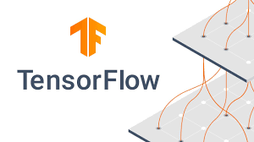
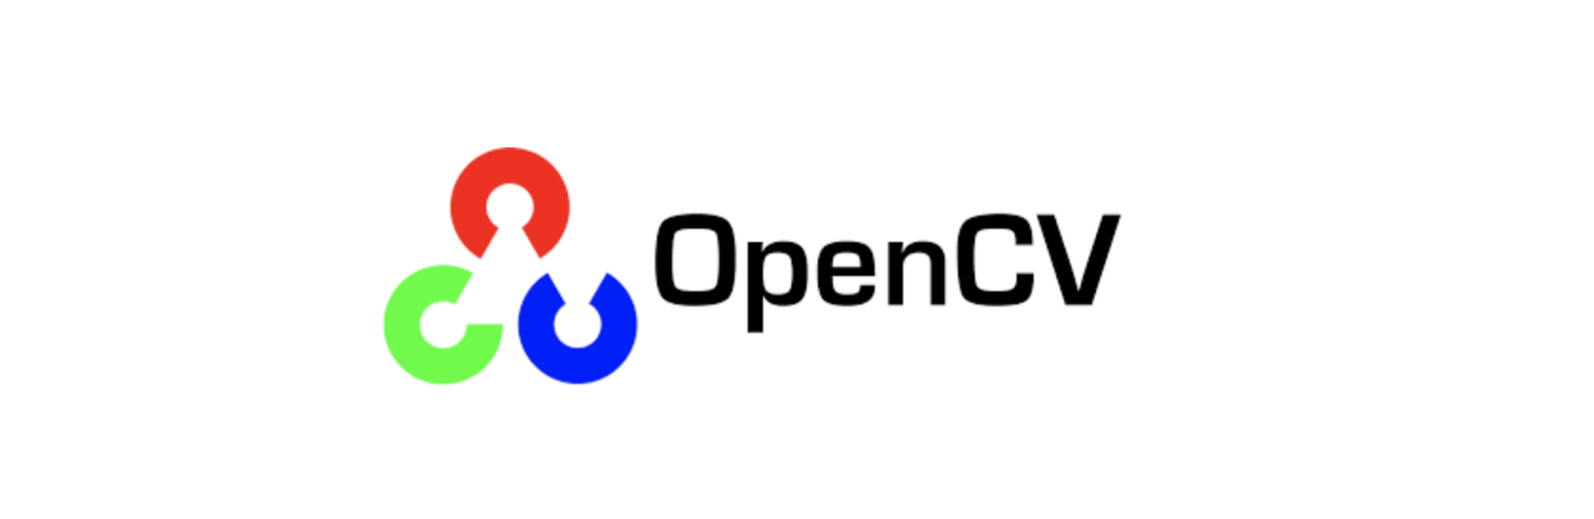
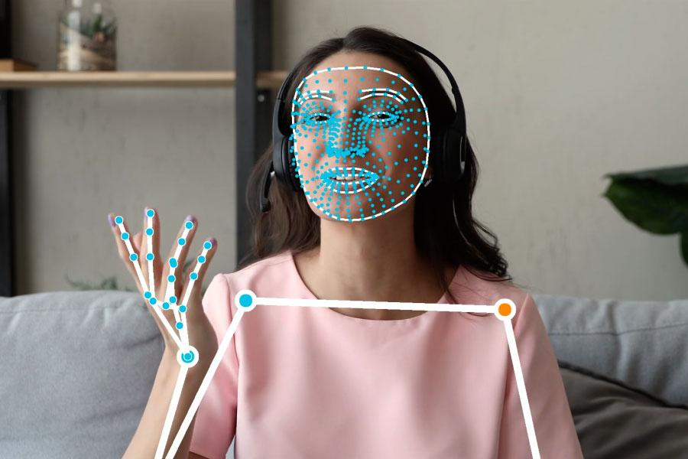
Program Architecture
Open Source - Off The Shelf Software
OpenCV - Computer Vision Libraries
MediaPipe - Holistic Detection of Hands, Face, and Pose Positions
TensorFlow Keras - Deep Learning Framework
Sequential Model
Five Linearly-Dependent Python Scripts
Step 1 - Dependency Installation (0-InstallDependencies.py)
Step 2 - Camera / OpenCV Testing (1-CamSetup.py)
Step 3 - MediaPipe landmark collection (2-CaptureSigns.py)
Step 4 - Keras Sequential Model Training (3-Learn.py)
Step 5 - Real-Time Sign Detection (4-SignDetection.py)
Notes:
modeling of input or output sequences of data.
Keras is a high-level neural networks API developed with a focus on enabling fast experimentation.

Slide 6
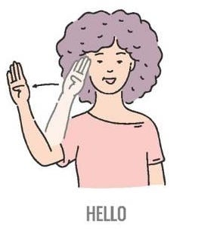
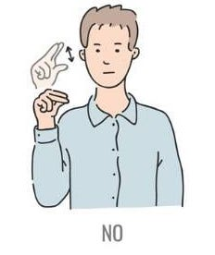

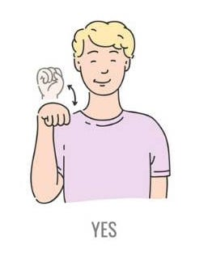
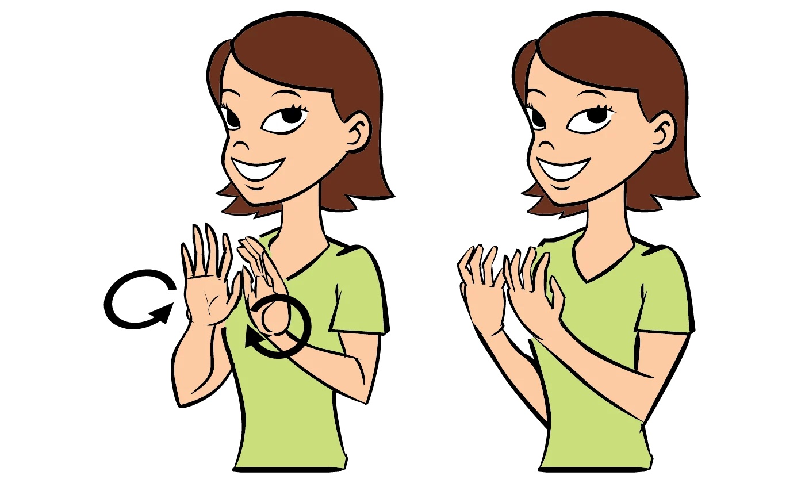
Signs Trained
Class
Accuracy of detection: Varies between 20% and 96%. More training is needed to improve accuracy.

Slide 7
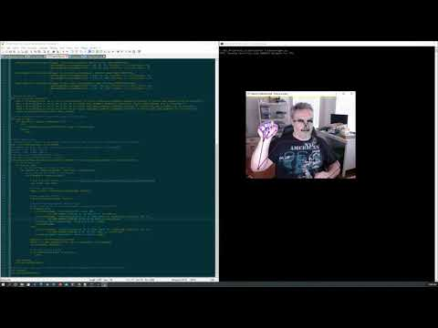
Demo
Quick demo showing the three primary scripts.
Capture
Training
Detection
This demo is showing a rough capture and limited training with a lot of false positives.

Slide 8
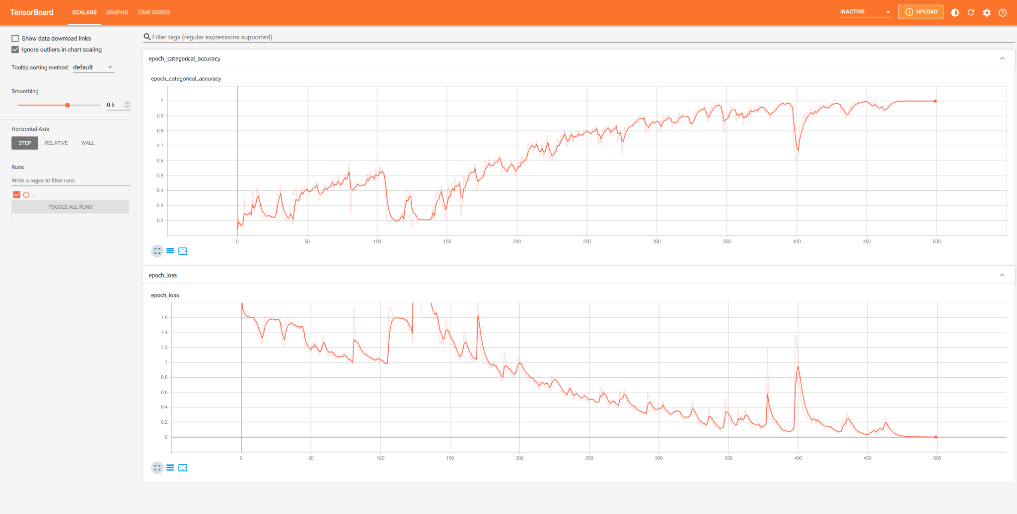
Visualizing the Data
Notes:
Tensorboard Scalar: It shows changes in loss and accuracy after every epoch.

Slide 9
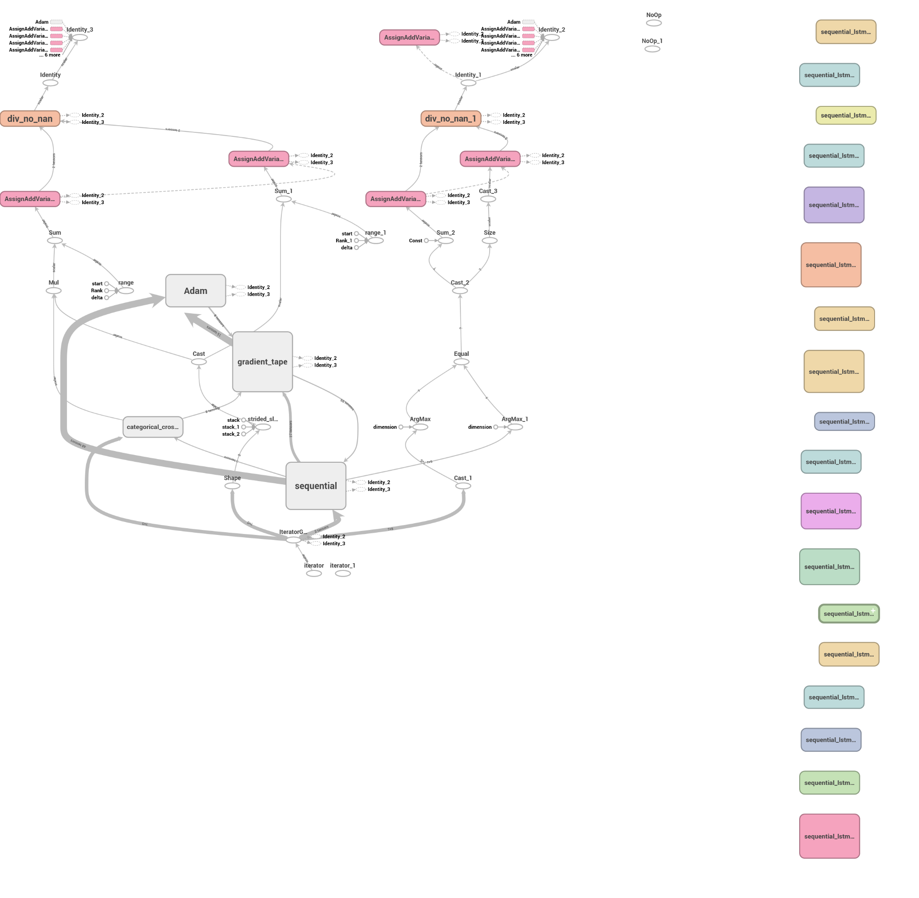
Notes:
Tensorboard graph. It shows the model’s design.

Slide 10
What We Discovered and
Challenges…
Similar Features
Signs Require Movement
Visual Interface is Needed
Small changes change the meaning of the sign.
Many ASL signs have a start and end location making training it difficult for our system to identity the changes.
In order for our system to work correctly, a visual interface like a smartphone, a raspberry pi would not be feasible.

Slide 11
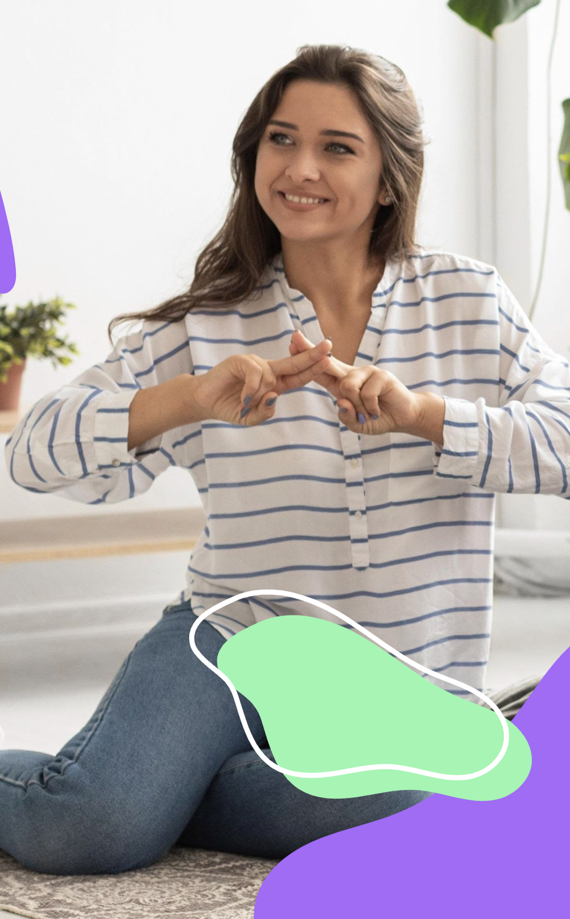
Conclusions and Project Expansion
Add more signs to the system.
Improve accuracy of the detection.
Add sentence and multi-sign recognition.
Add more complex signs.

Slide 12
THANK YOU

